Slide 1
KUBERNETES
Kubernetes is a orchestration engine , which is a containerization environment.
Kubernetes is also known as k8’s
Orchestration(management)
Kubernetes is a open source platform.
Kubernetes is a replacement of Docker Swarm
It is a group of containers into logical units called pods(can add multiple containers)

Slide 2
KUBERNETES – orchestration tool
High availability or no downtime
Scalability or high performance
Disaster Recovery – backup and restore
Advantages of Kubernetes
Auto scaling
Automated Rollbacks
Load Balancing
Self Healing

Slide 3
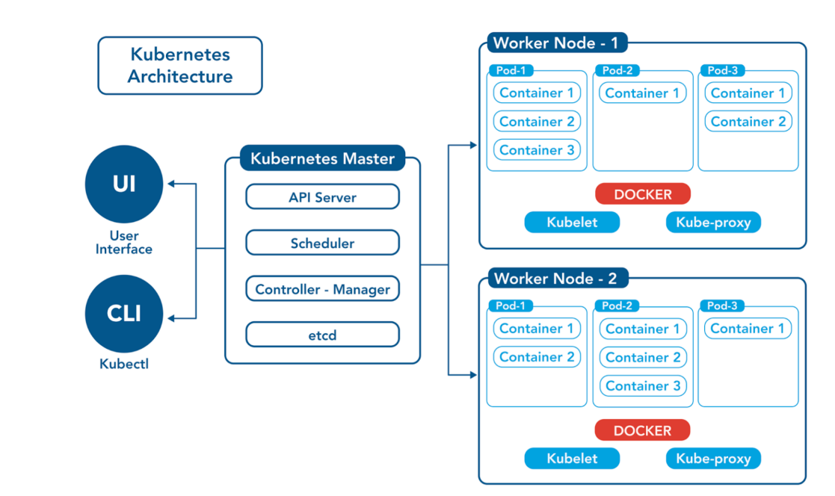
KUBERNETES – Architecture

Slide 4
KUBERNETES
API server
Interacts with APIs (frontend) – entry point to k8s cluster
Scheduler
Responsible to schedule the pods
Controller manager
Manages the tasks of the container – keeps track of what’s happening in the cluster
etcd
Key value pair model which stores information

Slide 5
KUBERNETES - components
Pod
smallest unit in Kubernetes
Can run multiple containers in one pod
Each pod gets its own IP address
New IP address on re-creation
Service
Permanent IP address
Lifecycle of pod and service not connected

Slide 6
KUBERNETES - components
Ingress
Gives domain name instead of IP address
https://app.com
configMap
External configuration of the application
DB_URL=mango-db
configMap is for non-confidential data only

Slide 7
KUBERNETES - components
Secret
Used to store secret data ( credentials)
Stored in encoded format
Reference secret in Deployment/pod
Volume
Attaches physical storage on the hardrive
Storage on local machine or remote , outside of the k8s cluster
Kubernetes does not manage data persistence

Slide 8
KUBERNETES - components
Deployment
Blueprint for app – pods
Deployments( can add replicas of the pods)
Database cannot be replicated via deployment
Statefulset
For database (stateful apps)
Example: mongodb mysql

Slide 9
Kubernetes – set up of Kubernetes cluster
Once all the setup of master node and worker node is done
sudo su –
Update the system
apt-get update
Install Http packages
apt-get install apt-transport-https
INSTALLATION OF DOCKER
apt install docker.io -y
docker version or docker –v ( to check whether docker installed properly)

Slide 10
Kubernetes – set up of Kubernetes cluster
To start the docker application
systemctl start docker
systemctl enable docker
Setup an Open GPG key – to install Kubernetes
sudo curl –s https://packages.cloud.google.com/apt/doc/apt-key.gpg | sudo apt-key add
nano /etc/apt/sources.list.d/Kubernetes.list
-deb http://apt.Kubernetes.io/ Kubernetes-xenial main
apt-get update
apt-get install –y kubelet kubeadm kubectl Kubernetes-cni

Slide 11
Kubernetes – set up of Kubernetes cluster
Initiate only in Master node
Kubeadm init
mkdir –p $HOME/.kube
sudo cp –i /etc/Kubernetes/admin.conf $HOME/.kube/config
Sudo chown $(id –u):$(id –g) $HOME/.kube/config
To communicate install networking plugins in worker nodes
Run flunner plugin in master node
kubectl apply -f https://raw.githubusercontent.com/coreos/flannel/master/Documentation/kube-flannel.yml

Slide 12
Kubernetes – set up of Kubernetes cluster
Once the flunner plugin is installed kubeadm token is generated
Example:
Kubeadm join 172.31.11.206:6443 –token bo…..
Add this token in the worker nodes
Kubectl get nodes – shows the status of the nodes

Slide 13
KUBERNETES
Development
-Kubernetes using Minikube
-Kubernetes using Docker for Desktop
Installer based
-Kubernetes with kubeadm
-Kubernetes with kops
-Kubernetes with kubespray
Managed(platform Based)
-EKS (AWS Elastic Kubernetes Service)
-AKS(Azure Kubernetes Service)
-GKE(Google Kubernetes service)

Slide 14
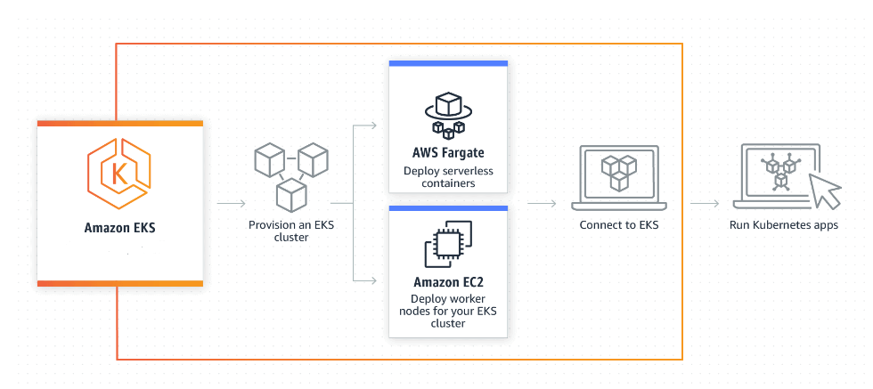
Kubernetes – EKS Architecture

Slide 15
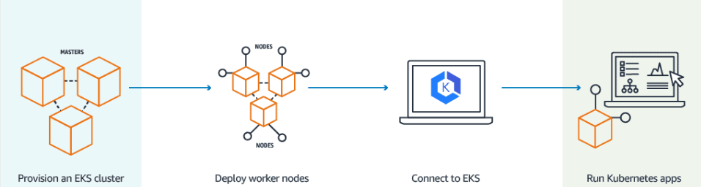
KUBERNETES - WORKFLOW

Slide 16
KUBERNETES – AWS CLI
https://docs.aws.amazon.com/cli/latest/userguide/getting-started-install.html
IN terminal
aws --version
aws configure
Create secret access key ID and add in the console
Install kubectl
https://docs.aws.amazon.com/eks/latest/userguide/install-kubectl.html
To check in CLI
kubectl

Slide 17
KUBERNETES
Connecting cluster through CLI
aws eks --region us-east-1 describe-cluster --name newcluster --query cluster.status
To know the service
Kubectl get svc
Create worker nodes in amazon console
EKS -> cluster -> compute -> nodes
Policies to give for worker node
AmazonEKS_CNI_Policy
AmazonEKSWorkerNodePolicy
AmazonEC2ContainerRegistryReadOnly

Slide 18
KUBERNETES
Once the node setup is done
Kubectl get nodes --watch
Kubectl get nodes
CRI – container runtime interface
CNI – container network interface
CSI – container storage interface

